Slide 1

Design, Develop, Implement, Test Document Used Car Sales Portal Website
Module Project
Module: Application Development & Process
Course: Applied Degree in Software Engineering
Start Date :
End Date :
Submission Date :
Learner Name :
Enrollment ID :
Presentation Date :
15/12/2022
Chathushi Jayarathna
18/01/2023
<ID>
20/01/2023
<Date>

Slide 2
Document History
Version Number | Effective Date of release | Summary of Included Changes | Author
1 | 18 Nov 22 | First Edition | Nilofar

Slide 3
Contents
S. No. | Description
01 | Project background, objective & deliverables
02 | List of software used
03 | Business Process
04 | Project Plan
05 | Stages of Risk Based Testing models
06 | Types of risks
07 | Risk Based Testing Strategies
08 | Security Testing
09 | Test plans and Test cases
10 | Logs of Test Results
11 | Modifications of fail Test Cases
12 | Project Results

Slide 4
1. Project Definition
Project Background
You have been approached by ‘ABC Cars Pte Ltd’ as a website developer to develop a Used Car Sales portal. Users will be able to register in the portal using the Registration Page. Users of the portal can search for Cars using Make, Model, Registration & Price Range. Users will be able to view the Car information after searching them. The portal allows users to login, post Car for sale.
Project Objective
There are 2 types of users in this Used Cars Sales portal. They are
Users
Administrator
Users should be able to perform following functions in the portal
Register in the Portal
Login to the Portal
Post a Car for Sale along with Picture upload
Deactivate an Existing car sale
Update their Profile after logging in.
Book an appointment for test drive
Post the bidding price

Slide 5
1. Project Definition
Administrators should be able to perform the following functions in the portal
Register in the Portal
Login to the portal
View List of Registered Users
Mark a User as Administrator
Activate / Deactivate a Car post
Update their profile
Approve or deny the users appointment based on the bidding
Transact the sales if price is right
Both Users & Administrator
Visit Home Page
View Car Listing
Search for a Car by Make, Model, Registration Year & Price Range
About Us Page
Contact Us Page

Slide 6
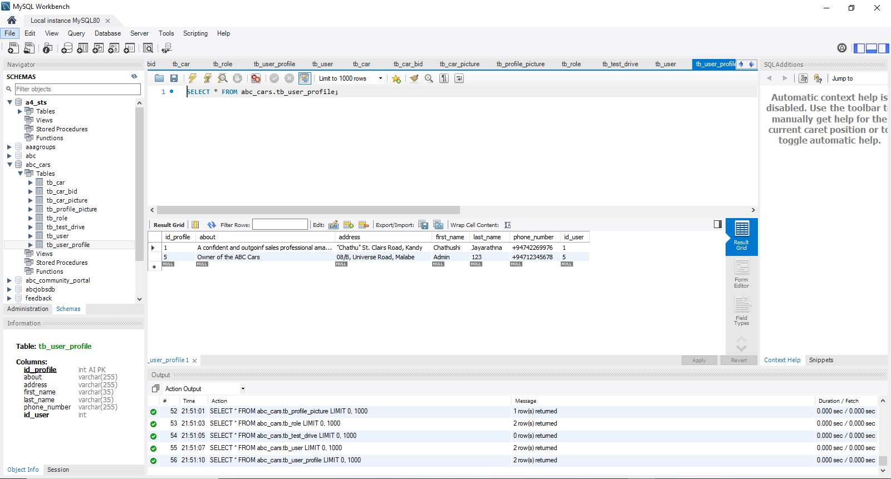
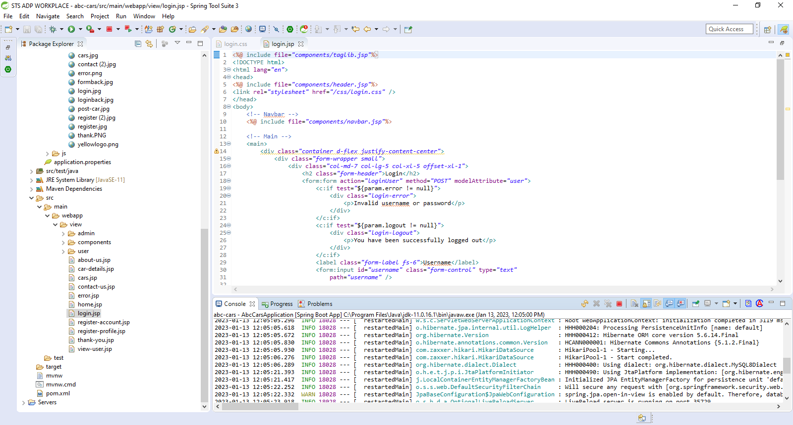
2. List of software used
MySQL Workbench
Spring Tool Suite

Slide 7
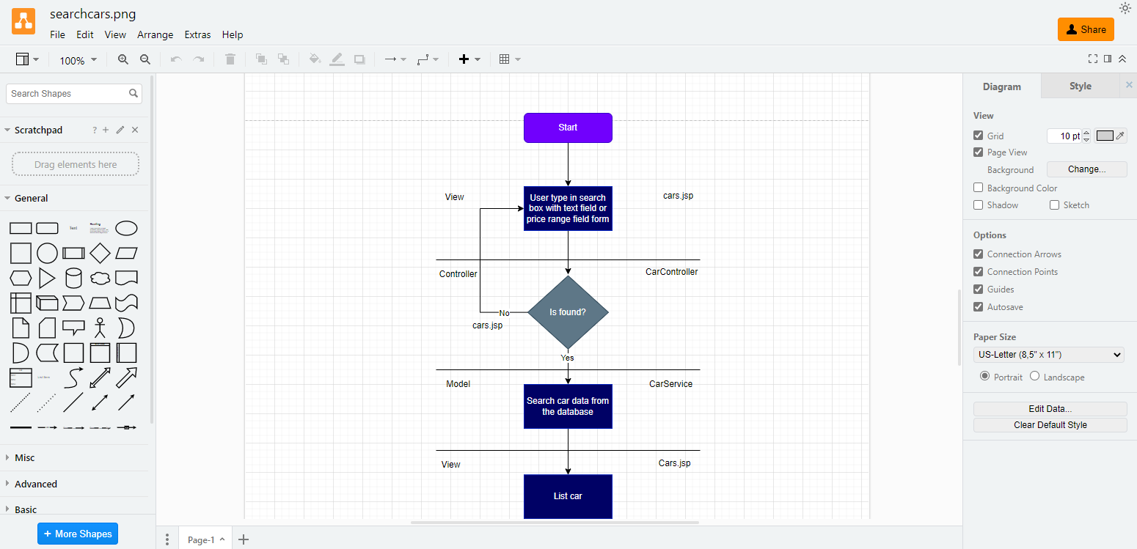

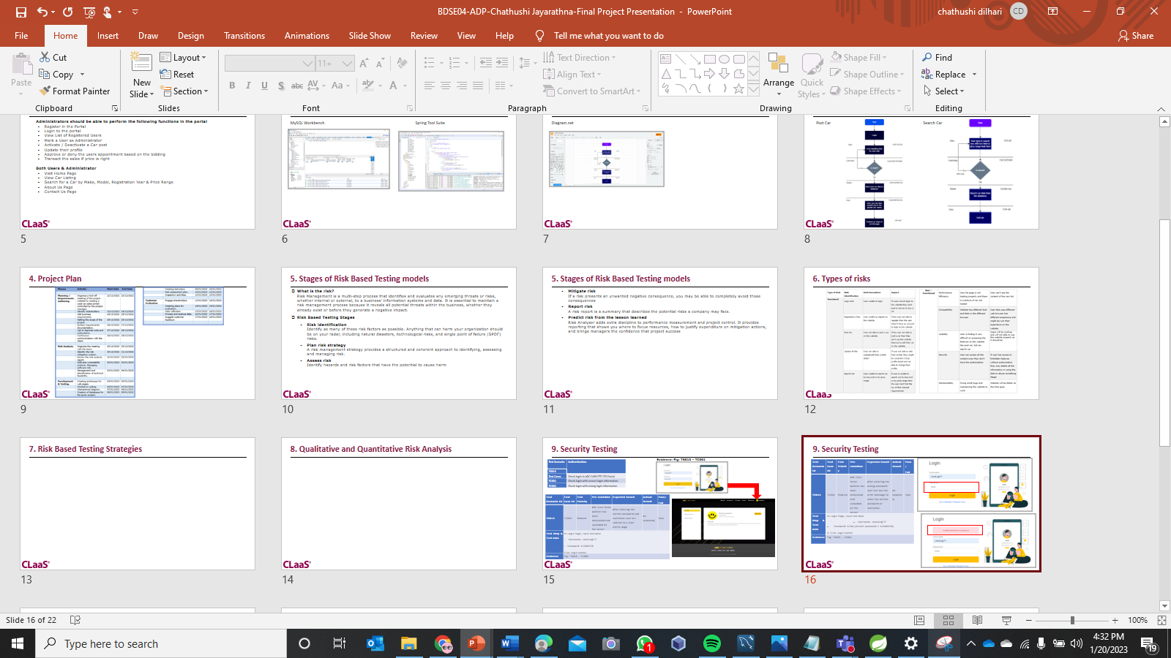
2. List of software used
Diagram.net
MS Word
MS PowerPoint

Slide 8
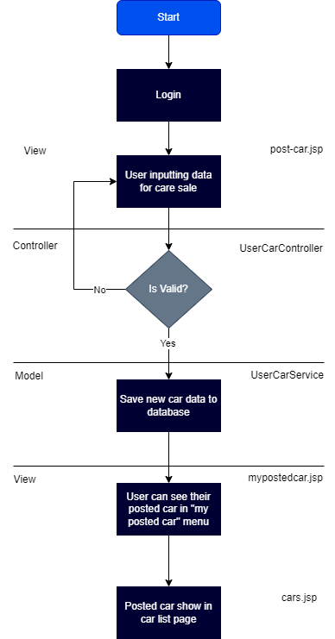
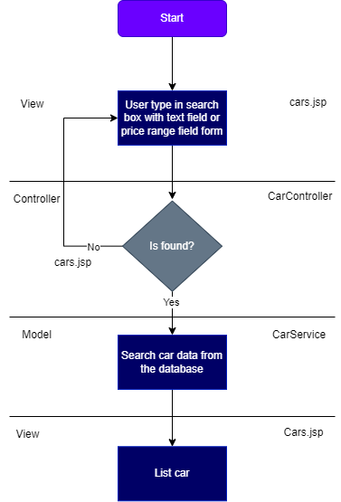
3. Business Process
Post Car
Search Car

Slide 9
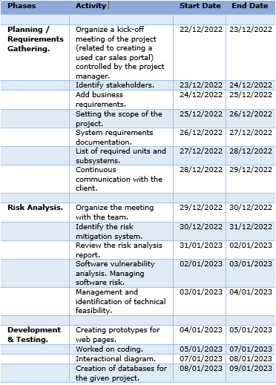
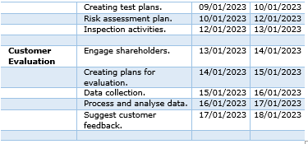
4. Project Plan

Slide 10
5. Stages of Risk Based Testing models
What is the risk? Risk Management is a multi-step process that identifies and evaluates any emerging threats or risks, whether internal or external, to a business’ information systems and data. It is essential to maintain a risk management process because it reveals all potential threats within the business, whether they already exist or before they generate a negative impact.
Risk Based Testing Stages
Risk identification Identify as many of these risk factors as possible. Anything that can harm your organization should be on your radar, including natural disasters, technological risks, and single point of failure (SPOF) risks.
Plan risk strategy A risk management strategy provides a structured and coherent approach to identifying, assessing and managing risk.
Assess risk Identify hazards and risk factors that have the potential to cause harm

Slide 11
5. Stages of Risk Based Testing models
Mitigate risk If a risk presents an unwanted negative consequence, you may be able to completely avoid those consequences
Report risk A risk report is a summary that describes the potential risks a company may face.
Predict risk from the lesson learned Risk Analyser adds extra discipline to performance measurement and project control. It provides reporting that shows you where to focus resources, how to justify expenditure on mitigation actions, and brings managers the confidence that project success

Slide 12
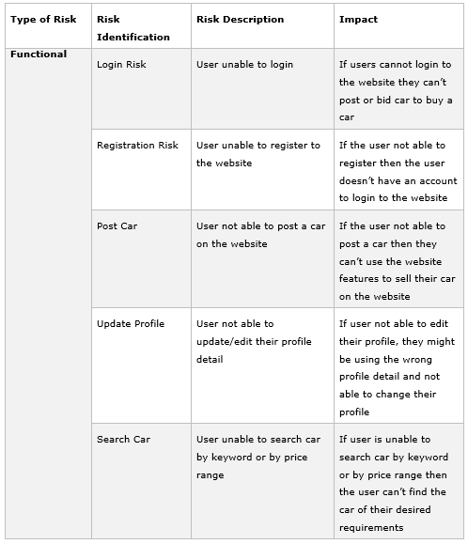
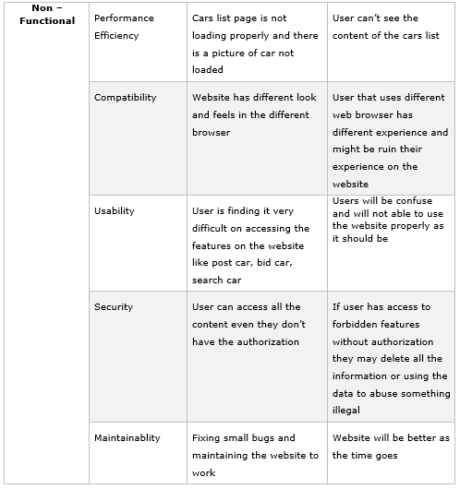
6. Types of risks

Slide 13
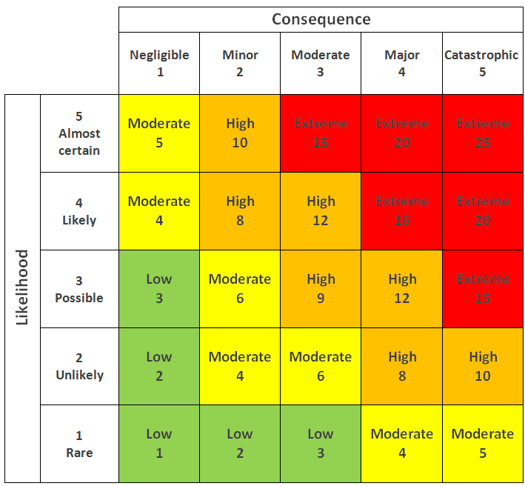
7. Risk Based Testing Strategies
How Risk Evaluation is conducted.
In general, to carry out an evaluation, it's miles vital to pick out risks. everyday working conditions, as well as maintenance, shutdowns, power outages, and emergencies, are affected. This consists of identifying risks, determining who can be harmed and how, assessing risks and determining control measures, reporting your findings, and identifying risks. The assessment is reviewed.
Insert the 5x5 matrix that’s used in the risk assessment

Slide 14
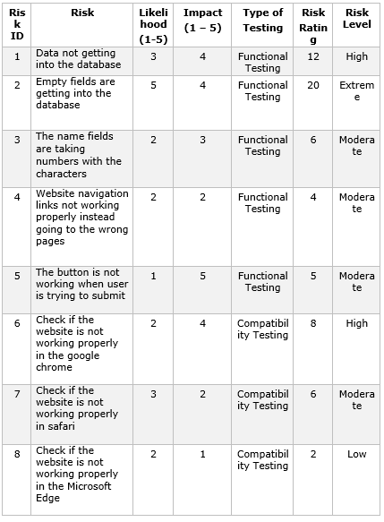
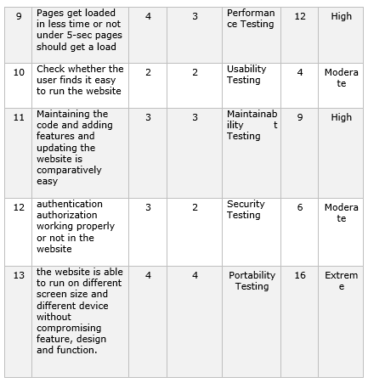
7. Risk Based Testing Strategies

Slide 15
7. Risk Based Testing Strategies
Type of Testing | Main Purposes
Functionality | The purpose of the test is to ensure that the features based on project requirements are working as intended.
Performance | To ensure the performance of the webpages are consistent with the project requirement below 3 seconds.
Compatibility | The goal of it to ensure that the website works properly within multiple browsers.
Usability | The main purpose is to ensure that the website interfaces are able to be understood and can be accessed by most visitors.
Security | The main purpose of the test is to identify any potential threats from the external party that would access the website and create exploitation to the website.
Portability | The goal is to ensure that the website could be accessed using multiple different devices.
Maintainability | The main purpose is to determine how suitable the project is for maintenance in difficulty wise.

Slide 16
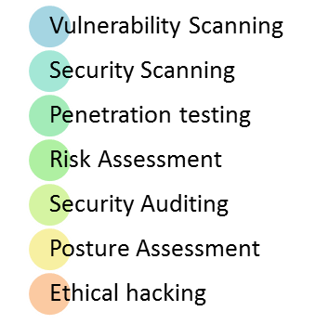
8. Security Testing
What is Security Testing ?
Security testing is a sort of software program testing that uncovers vulnerabilities, threats, risks in a software program software and prevents malicious assaults from intruders. The purpose of security tests is to identify all feasible loopholes and weaknesses of the software program system which might bring about a lack of statistics, sales, reputation at the palms of the personnel or outsiders of the corporation
Type of Security Testing

Slide 17
8. Security Testing
Vulnerability Scanning: this is carried out thru automatic software to experiment with a system against recognized vulnerability signatures.
Security Scanning: It involves identifying network and machine weaknesses, and later offers solutions for decreasing these risks. This scanning can be done for both manual and automated scanning.
Penetration testing: This form of testing simulates an attack from a malicious hacker. This trying out includes the evaluation of a selected gadget to test for capacity vulnerabilities to an outside hacking try.
Risk assessment: This testing involves analysis of security risks observed inside the company. Risks are categorized as Low, Medium, and excessive. This checking out recommends controls and measures to reduce the risk.
Security Auditing: This is an inner inspection of packages and operating systems for safety flaws. An audit also can be executed via line-by-line inspection of code
Ethical hacking: It’s hacking a company software program system. In contrast to malicious hackers, who thieve for their own gains, the cause is to expose safety flaws inside the device.
Posture assessment: This combines security scanning, moral Hacking, and risk assessments to reveal a usual safety posture of a business enterprise.

Slide 18
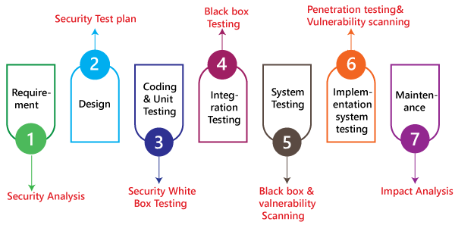
8. Security Testing
Among test strategies, how to carry out security testing.
The ABC cars project’s security testing method,
The security checking out technique for the car Portal project is completed via Spring Boot security.
In Most of the testing strategies, vulnerability evaluation is used within the Safety testing procedure.
The password supplied for the duration of registration and get entry to the ABC car Project has to be stored in an encrypted shape.
Invalid users ought to no longer be allowed to get entry to the application or system.
For the software, cookies and session time should be checked.
The browser's returned button has to not work on financial websites.
other pages cannot be accessed without a login.
Everybody concerned must set expectations and only display applicable Pages to users and administrators.
Provides material for project managers and program managers to
Develop and put into effect their own plans.
Test phases in security testing.
Security testing is carried out after the software implementation phase or after deployment. Also, if its miles are postponed, the value will increase. Consequently, security testing is involved in the early stages of the SDLC life cycle. SDLC levels are numerous safety system stages. That is necessities, design, coding and unit testing, integration testing, system testing, implementation, and support

Slide 19
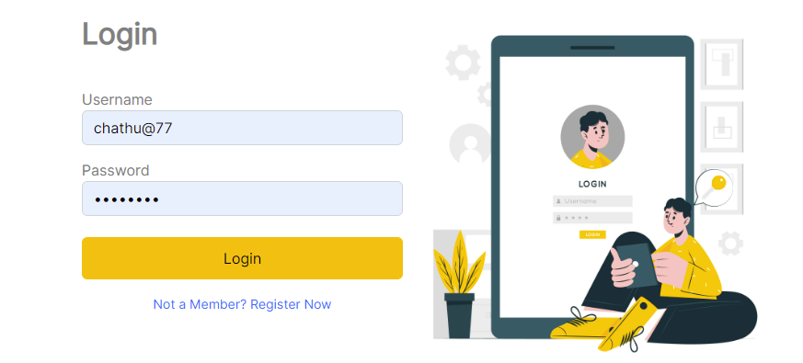
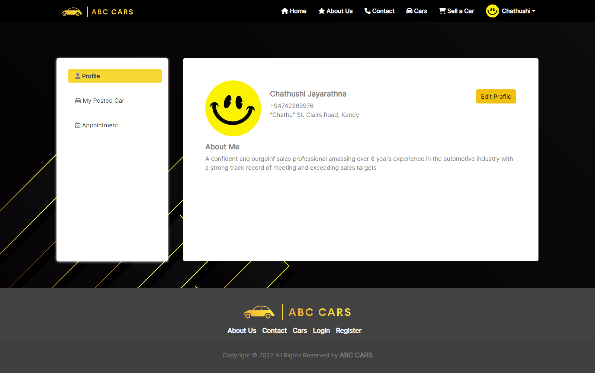
8. Security Testing
Evidence: Fig: TS015 – TC001
Test Scenario | Authentication.
TS015
Test Cases | Check login in ABC CARS PTE LTD Portal
TC001 | Check login with correct login information.
TC002 | Check login with wrong login information.
Test Scenario ID | Test Case ID | Test Priority | Pre-condition | Expected Result | Actual Result | Pass/ Fail
TS015 | TC001 | Medium | ABC Cars Portal website has been completed and uploaded on the server | After entering the correct password and username user will redirect to a User profile page | As expected, | Pass
Test Step & Test data | In Login Page, input test data Username- chathu@77 Password: 12345678 Click Login button
Evidence | Fig: TS015 – TC001

Slide 20
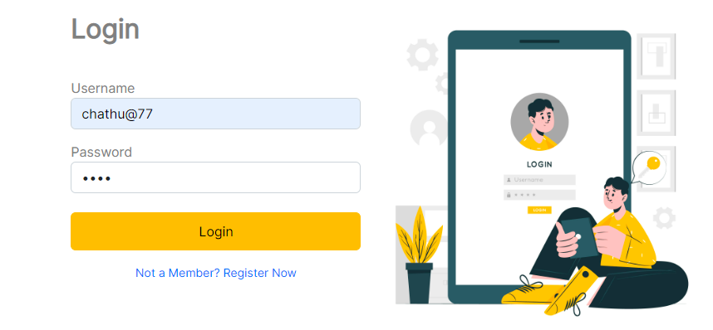
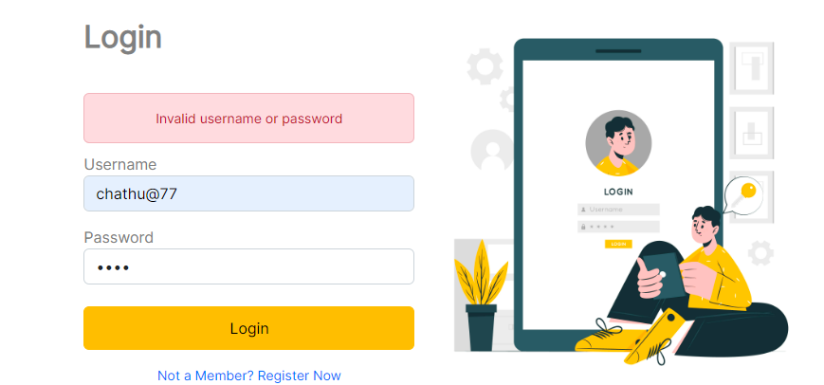
8. Security Testing
Test Scenario ID | Test Case ID | Test Priority | Pre-condition | Expected Result | Actual Result | Pass/ Fail
TS015 | TC002 | Medium | ABC Cars Portal website has been completed and uploaded on the server | After entering the wrong password user can see the error message to enter the correct password or username. | As expected, | Pass
Test Step & Test data | In Login Page, input test data Username- chathu@77 Password: 1234 (correct password = 12345678) 3. Click Login button
Evidence | Fig: TS015 – TC002

Slide 21
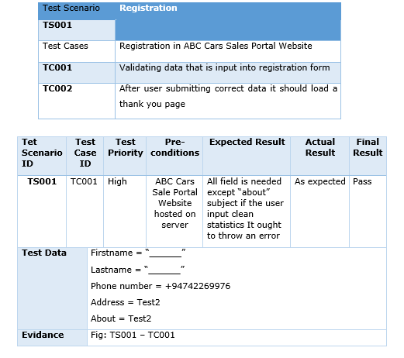
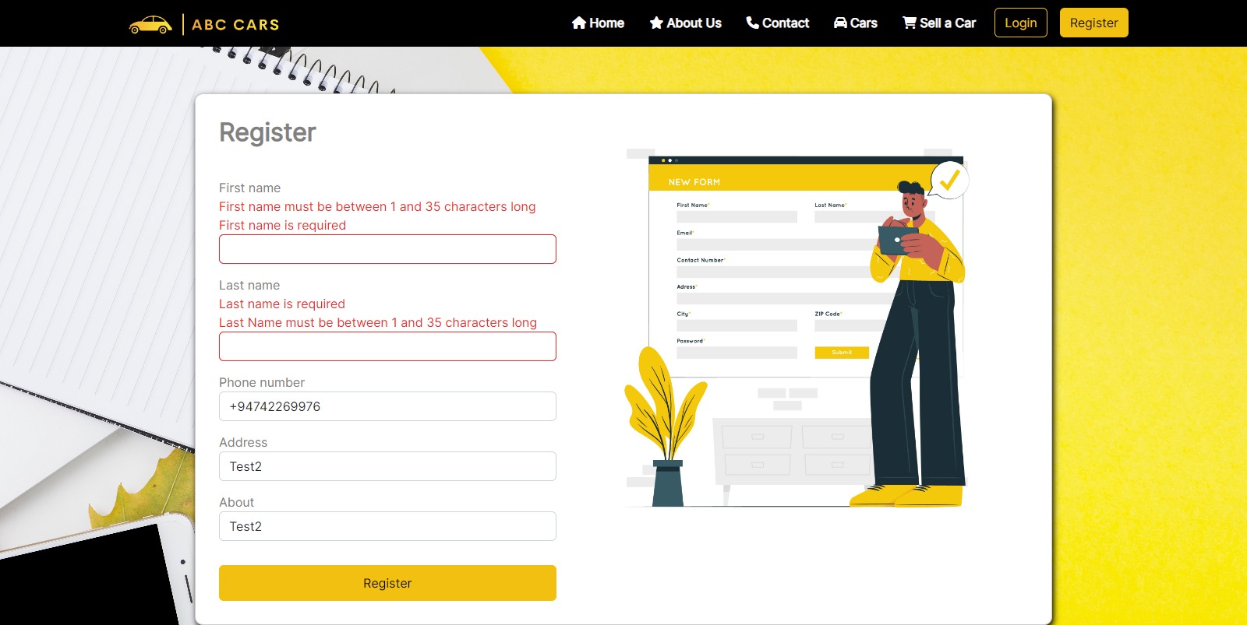
9. Test plans and Test cases
Test plan : A Test Plan is a concept and deliverable that …..
Test case : The test case is a sequence of steps that help us perform a certain test in the project.
Functional Testing – UAT testing
Evidence: Fig: TS001 – TC001

Slide 22
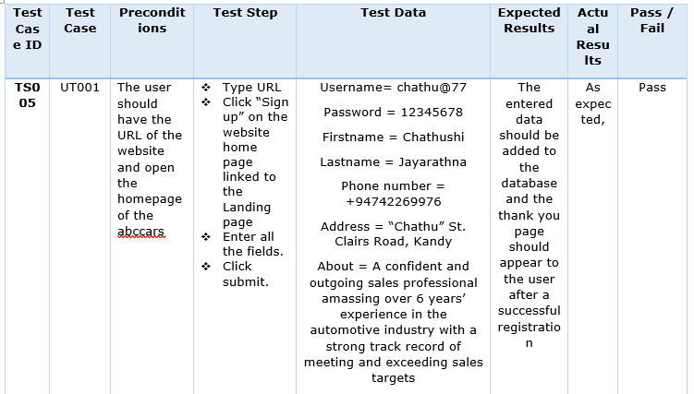
9. Test plans and Test cases
Unit Testing
Test Scenario | To ensure registration
TS00
Test Cases | Unit Testing
UT001 | Ensure that registration working correctly

Slide 23
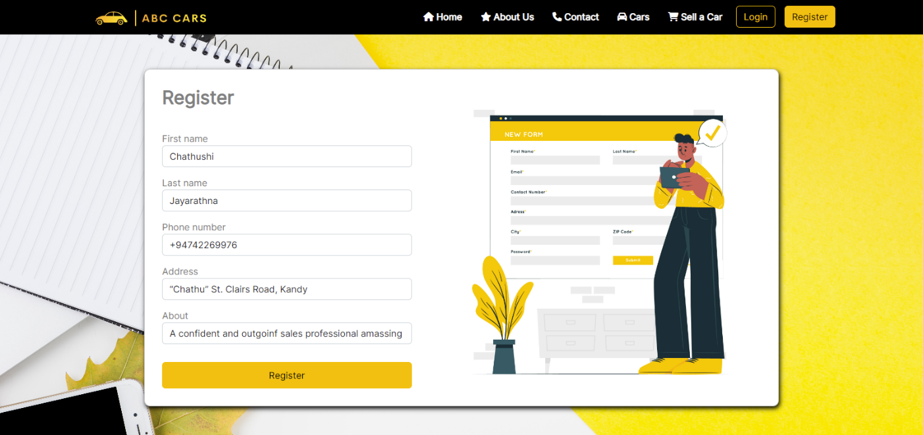
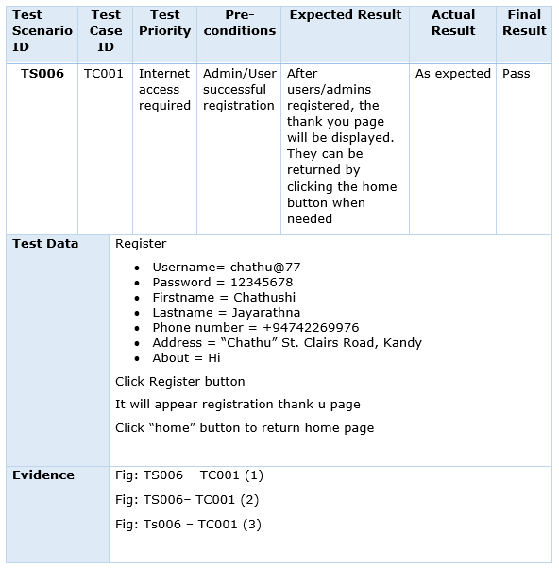
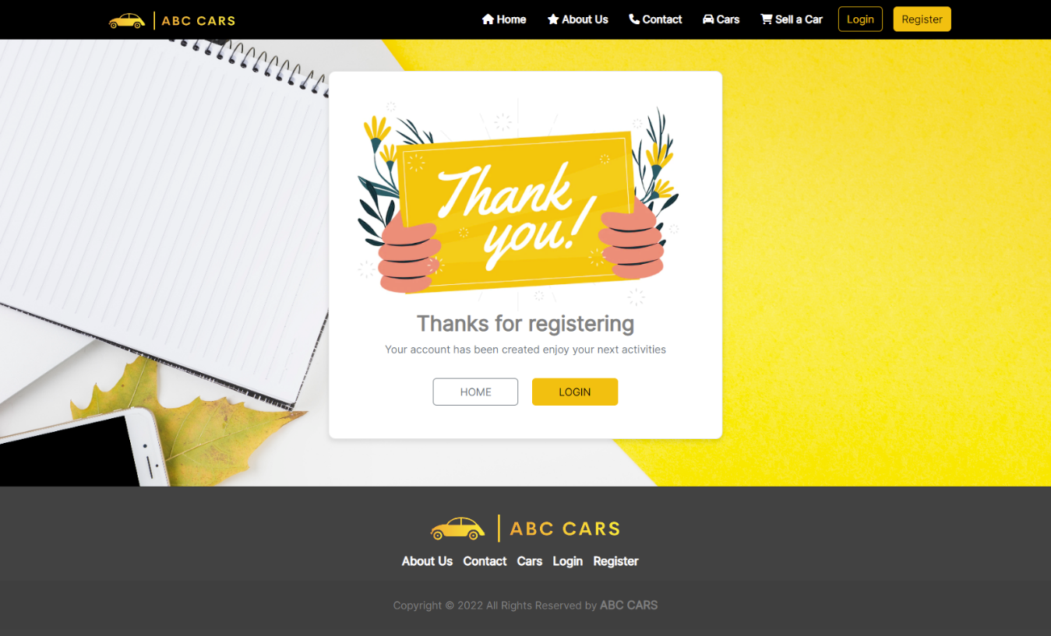
9. Test plans and Test cases
Performance Testing
Evidence: Fig: TS001 – TC001 (1)
Test Scenario | Ensure that the user or admin can access the home page at the required time.
TS006
Test Cases | Performance Testing
TC001 | Test cases Loading Time/ speed checking out

Slide 24
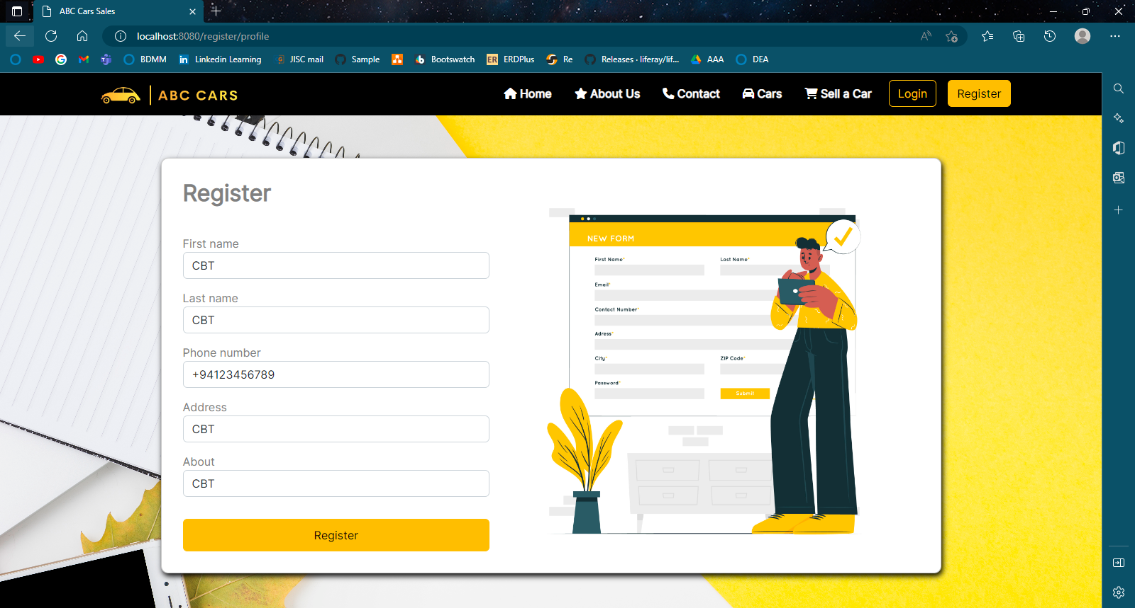
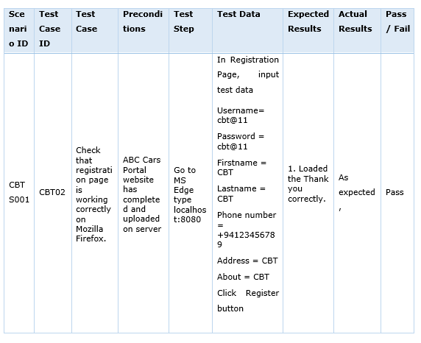
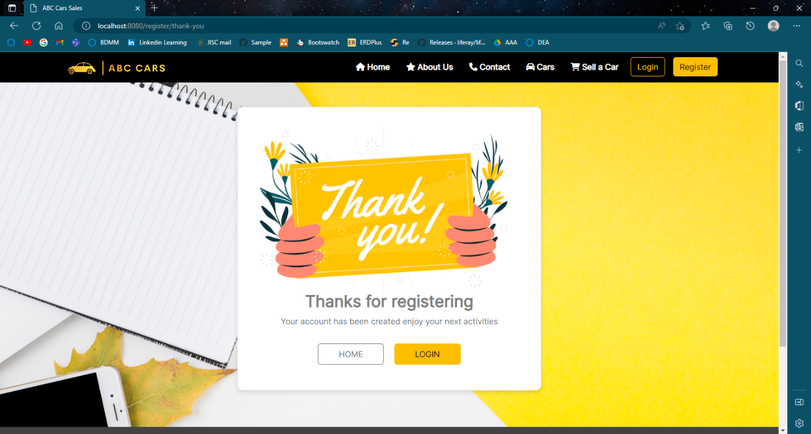
9. Test plans and Test cases
Compatibility Testing

Slide 25

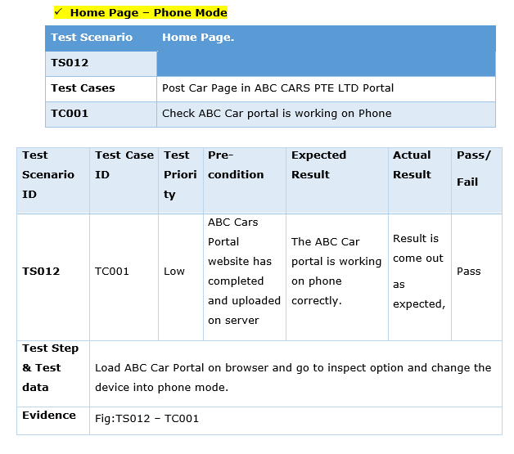
9. Test plans and Test cases
Portability Testing

Slide 26
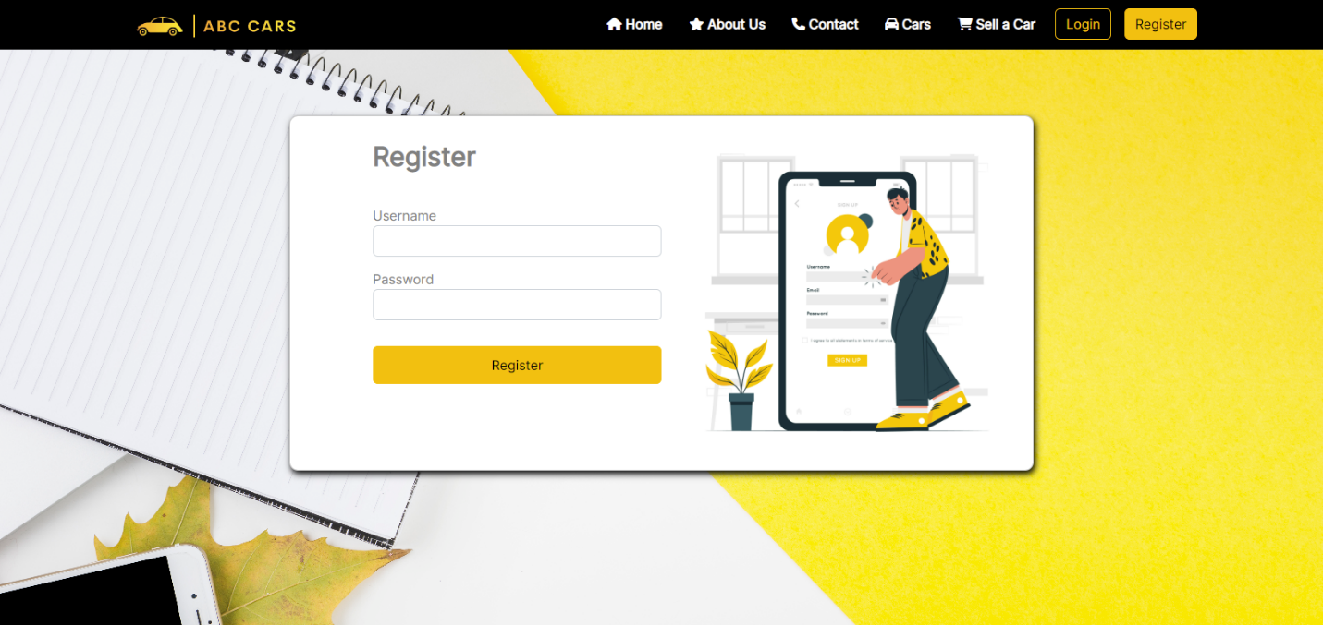
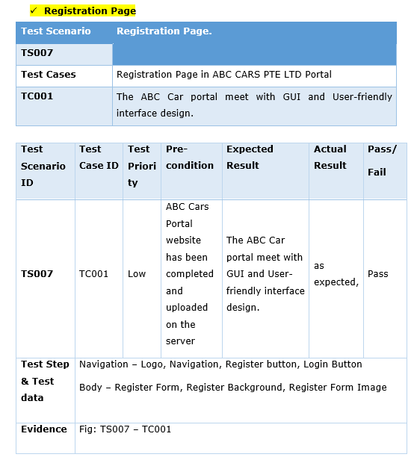
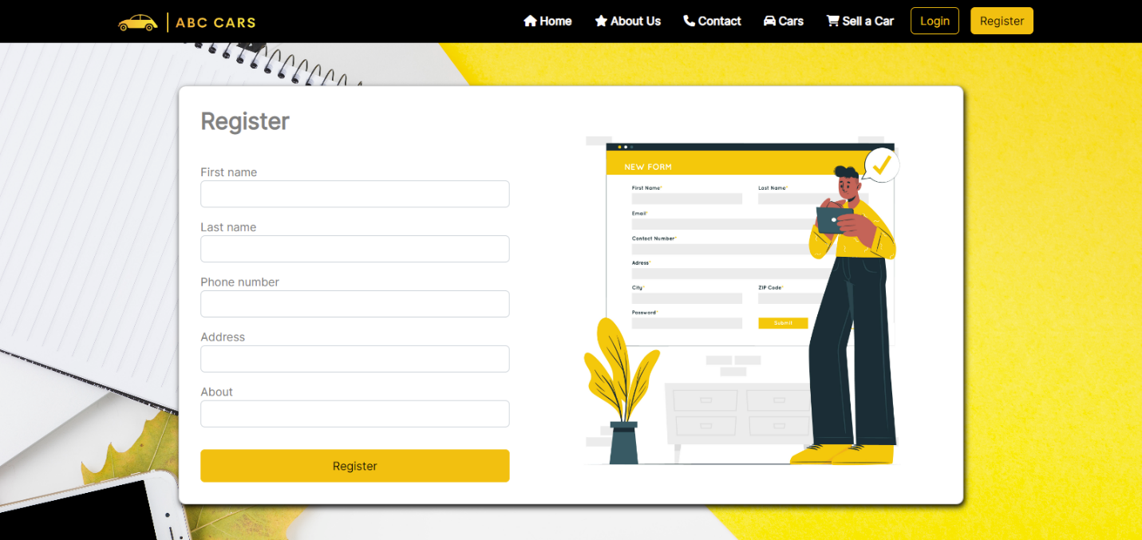
9. Test plans and Test cases
Usability Testing

Slide 27
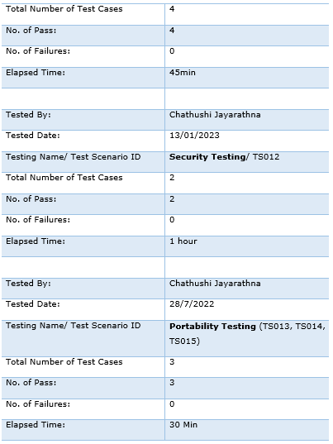
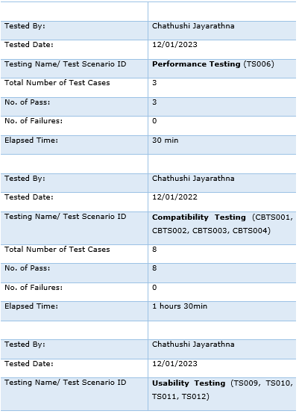
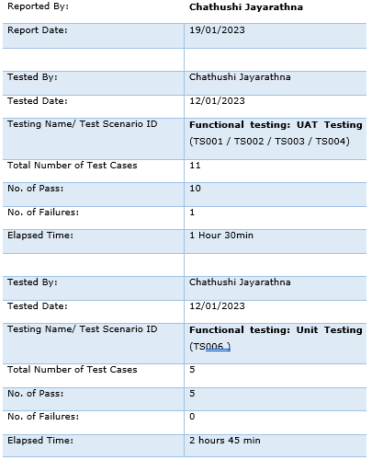
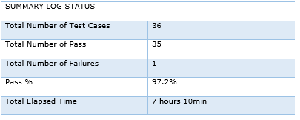
10. Logs of Test Results

Slide 28
11.Modifications of fail Test Cases
Test result after modification
Project ID/ Project Name: | Used Car Sale Portal Project
Reported By: | Chathushi Jayarathna
Report Date: | 19/01/2023
Tested By: | Chathushi Jayarathna
Tested Date: | 19/01/2023
Testing Name/ Test Scenario ID | UAT Testing
Total Number of Test Cases | 1
No. of Pass: | 1
No. of Failures: | 0
Elapsed Time: | 10min

Slide 29
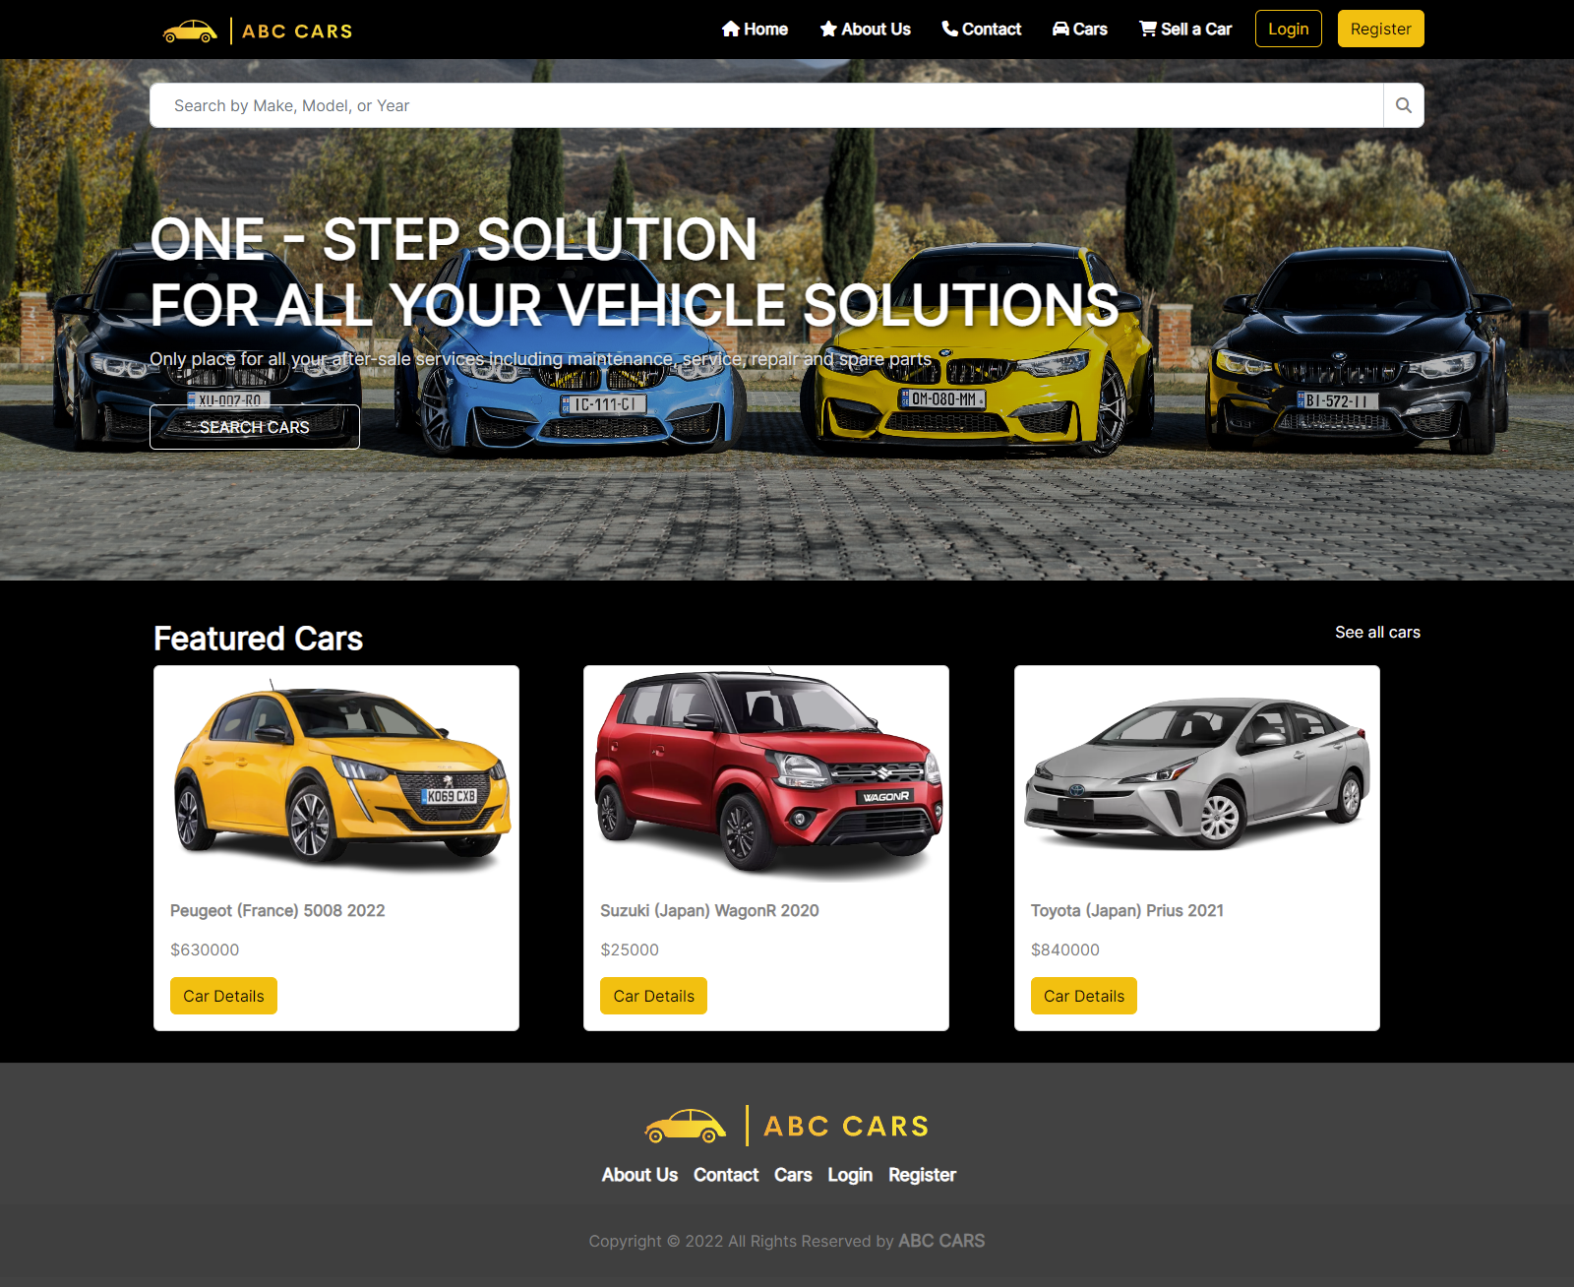
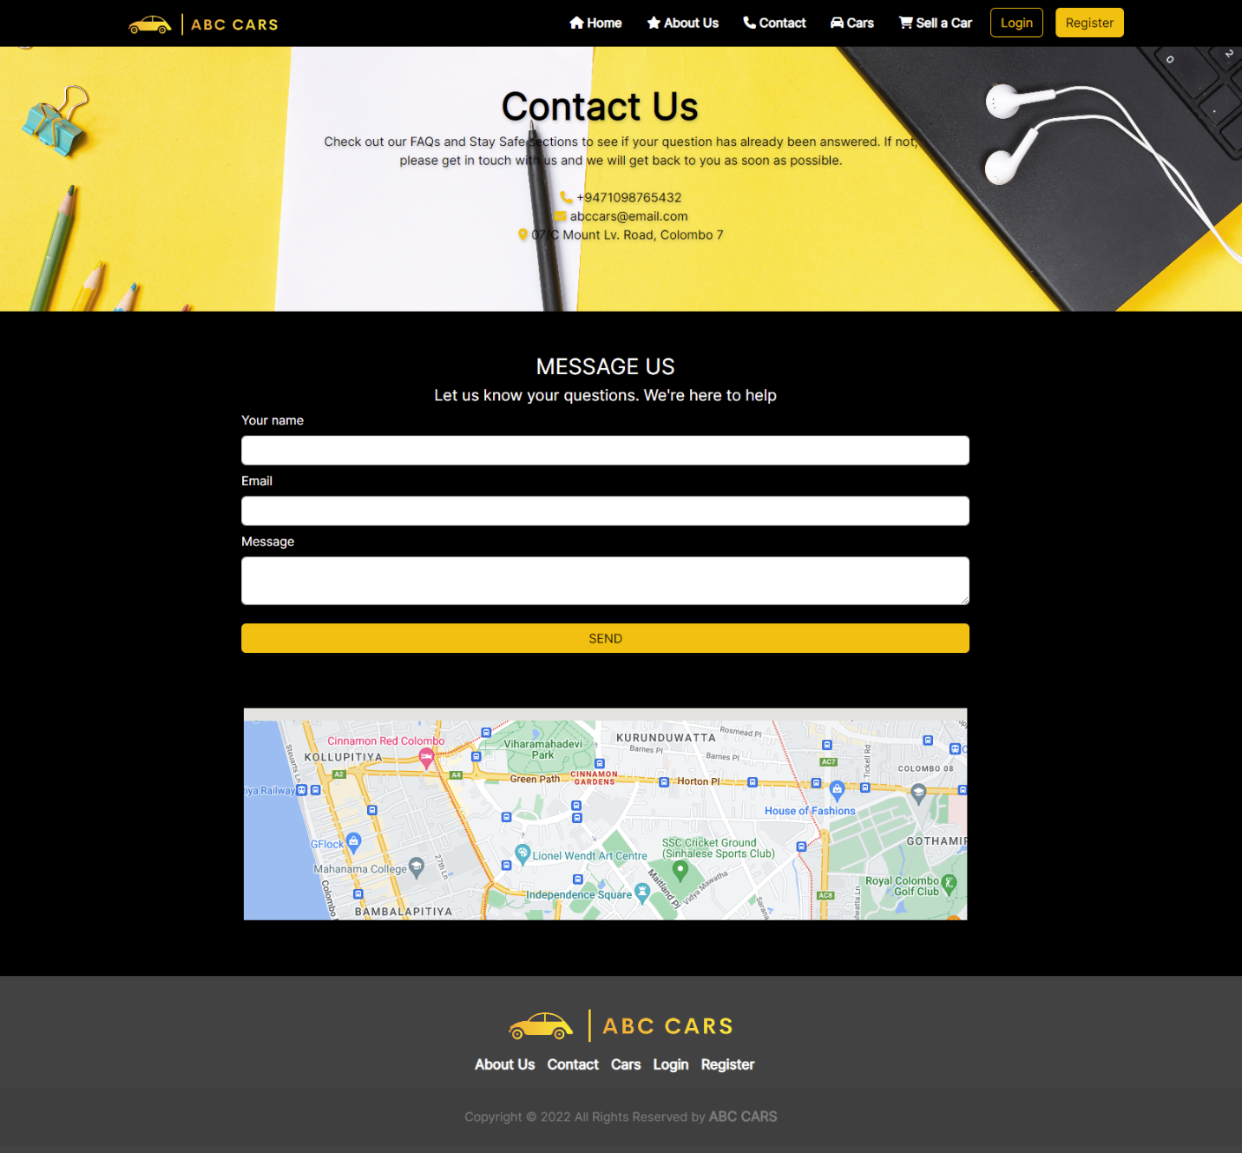
12. Project Results
Home Page
Contact us

Slide 30


12. Project Results
About Us Page
Login

Slide 31

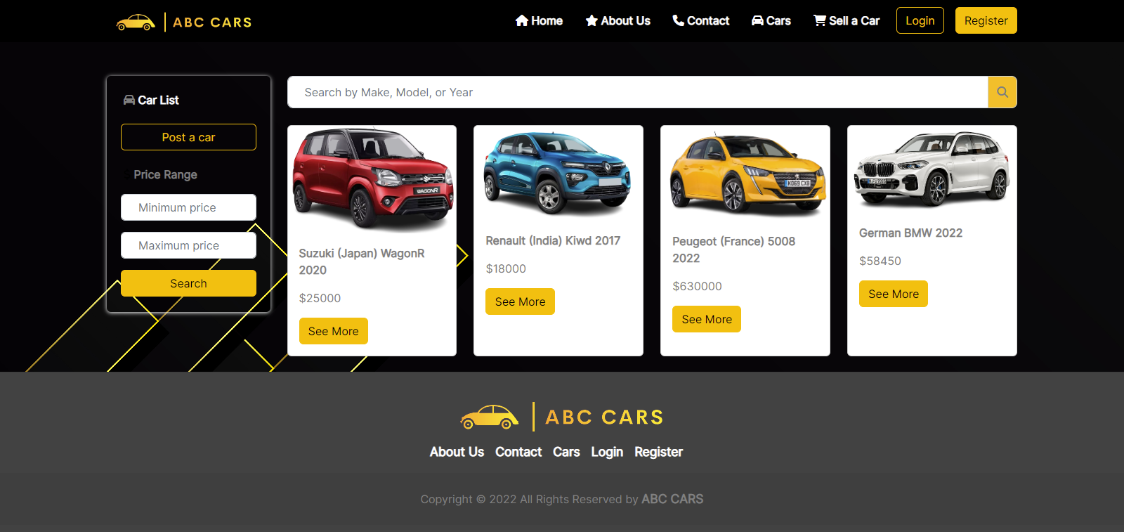

12. Project Results
Register Account
Car List View Page

Slide 32
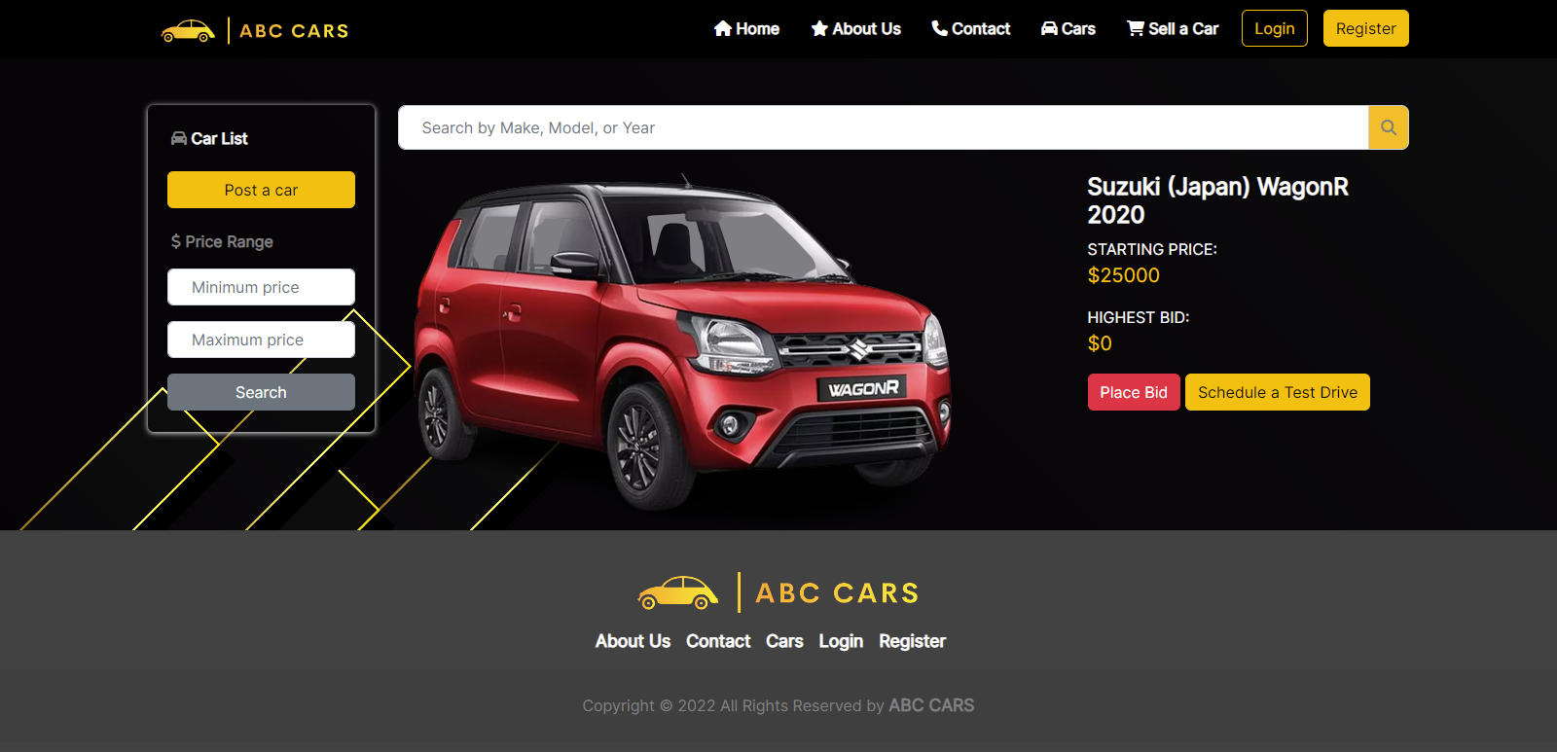

12. Project Results
Car Details View Page
User Profile

Slide 33
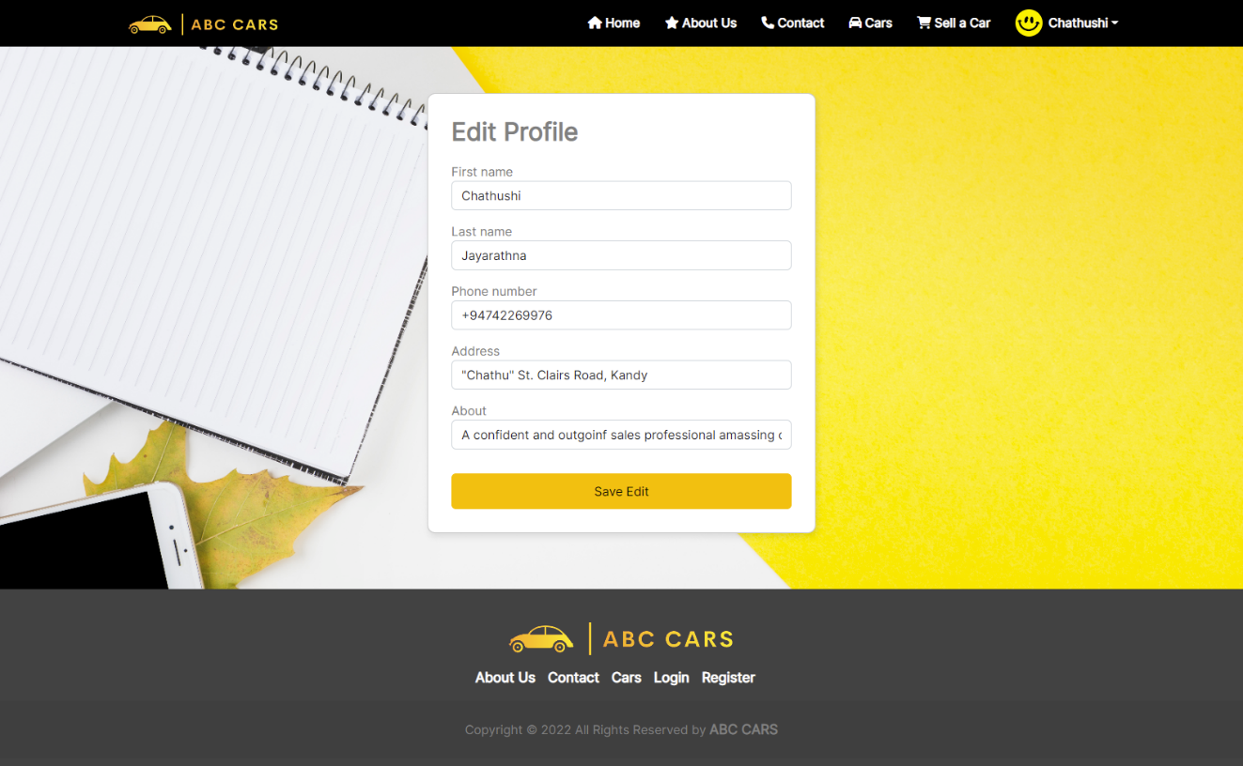
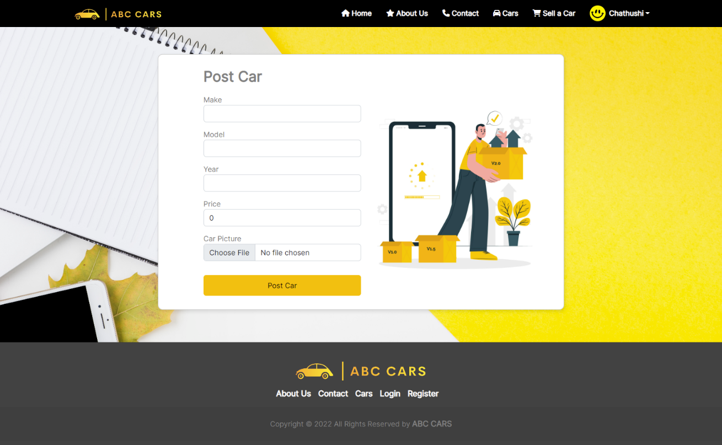
12. Project Results
User Edit Profile
User Post Car Page

Slide 34
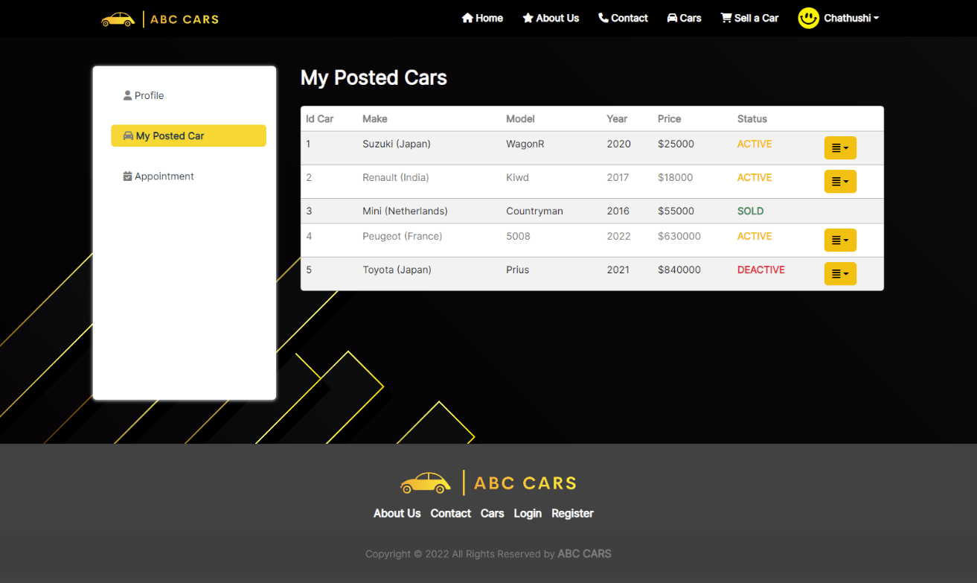
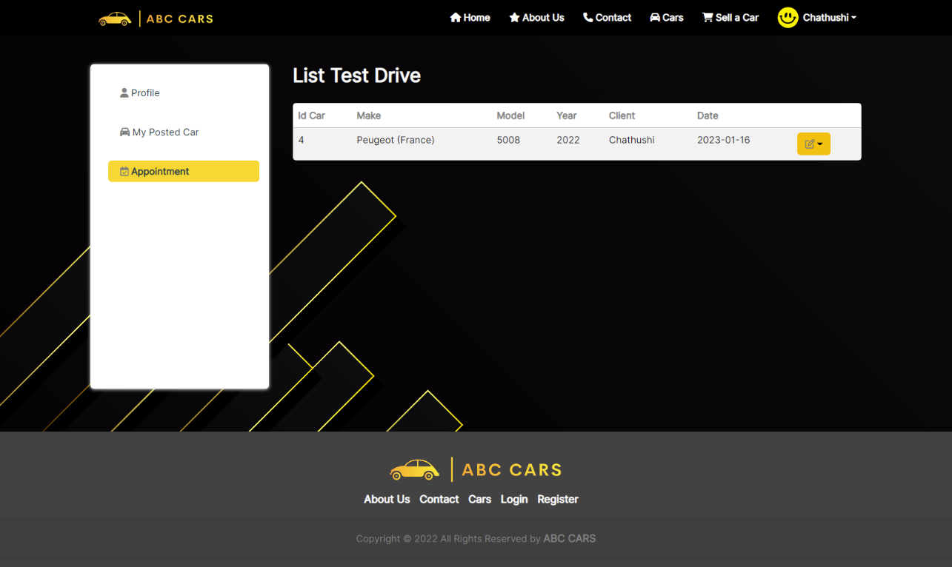
12. Project Results
User Posted Car List
User List Test Drive Car

Slide 35
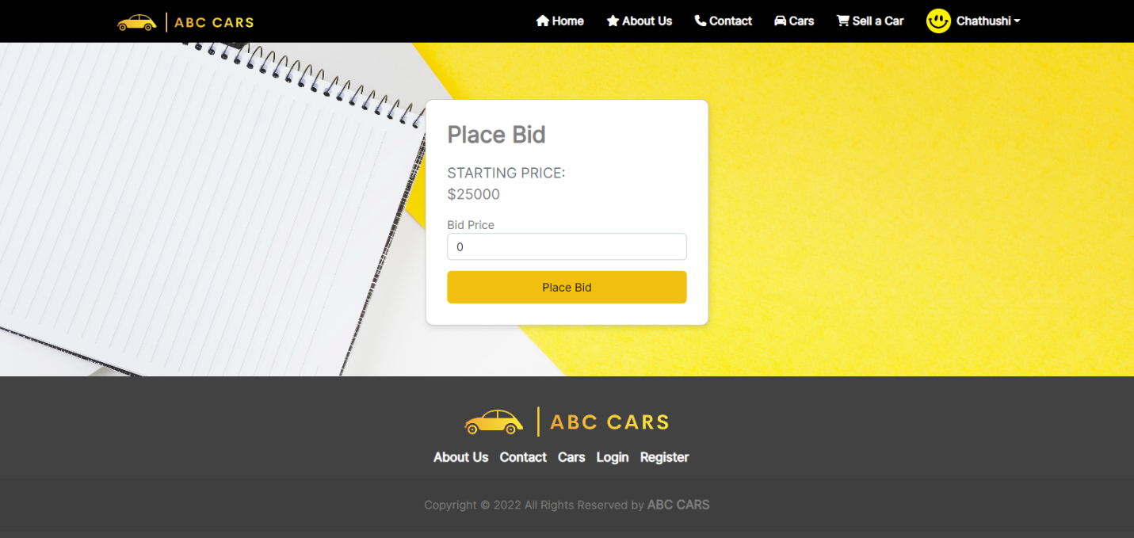
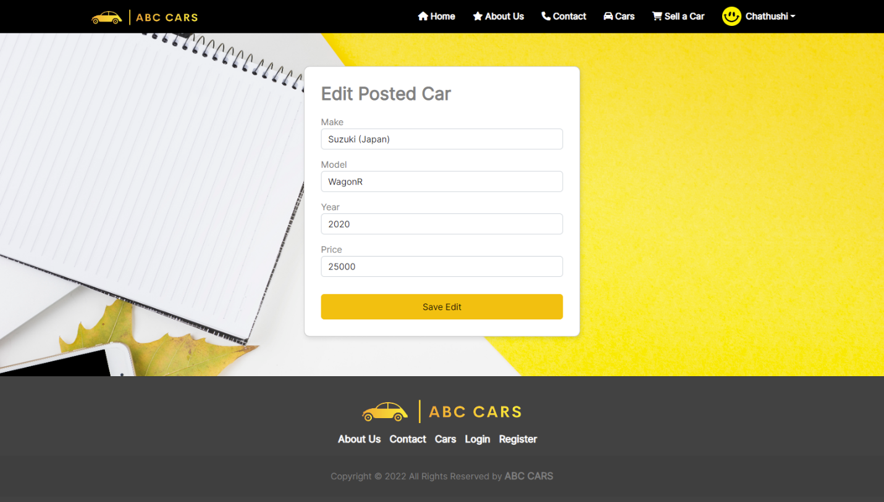
12. Project Results
Car Bidding
Edit Posted Car Details

Slide 36
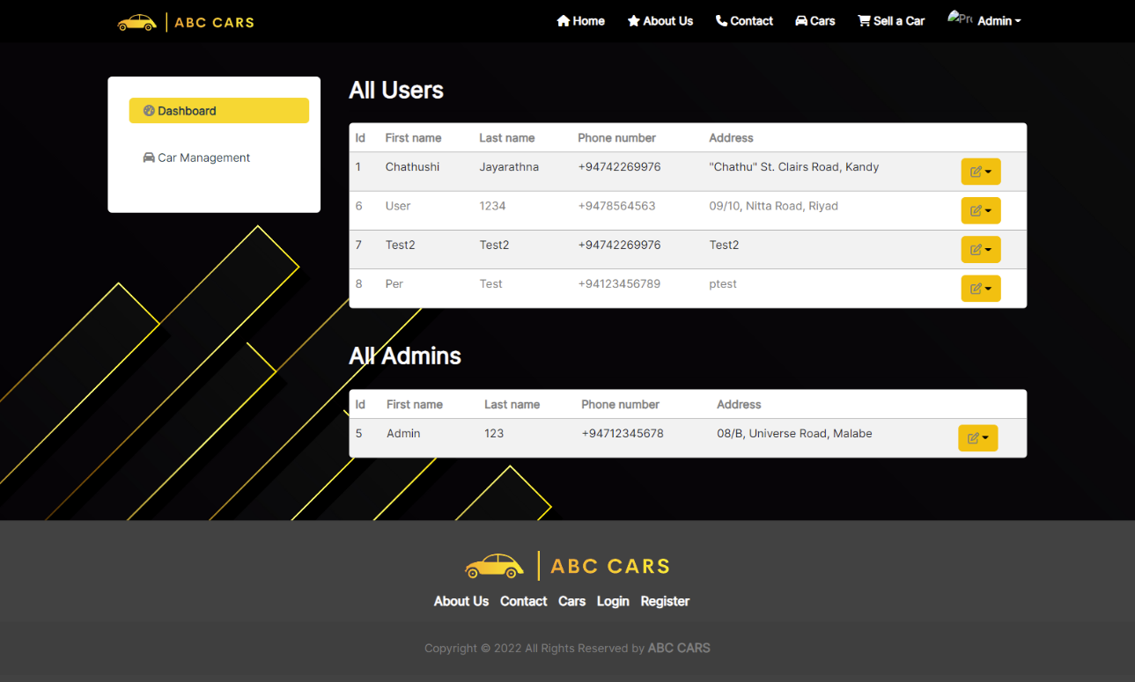
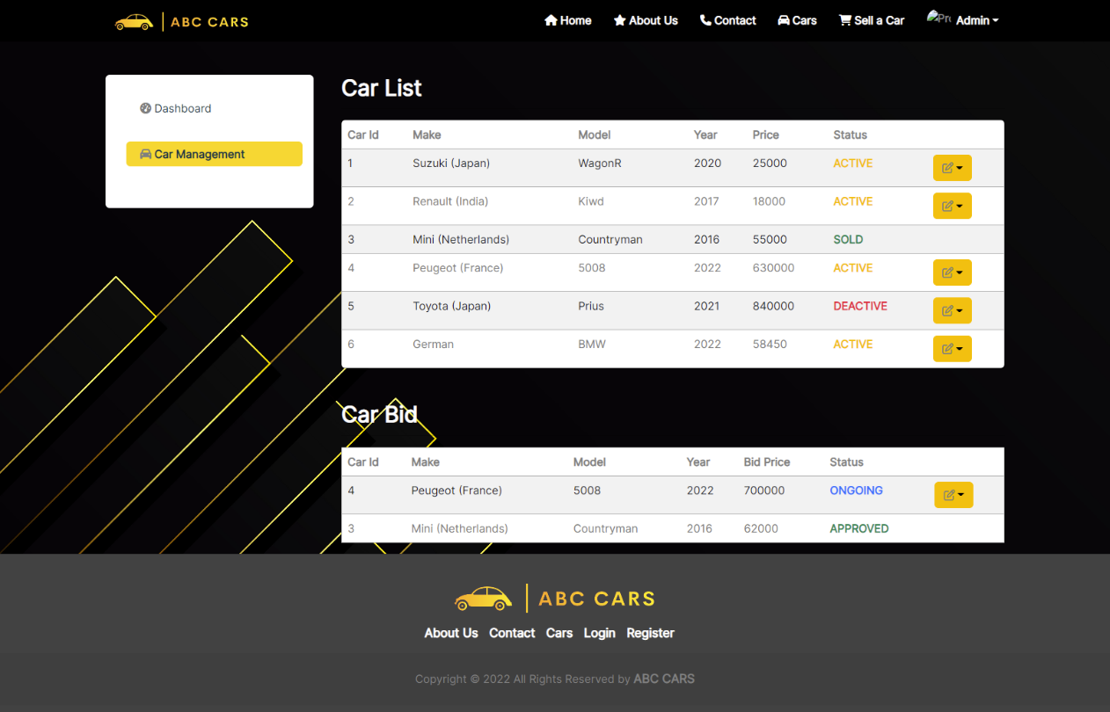
12. Project Results
Admin Dashboard
Admin Car Management

Slide 37

12. Project Results
Registration Thank You

Slide 38
Thank you

